Slide 1
Authentication Of client and hosted server Api using Auth0
Anju munoth

Slide 2
Registering the Blazor WASM App with Auth0
Auth0 - Provides an easy way to integrate authentication and authorization without having to deal with the complexity of the underlying technology.
To use Auth0, need to provide some information and configure your application to make the two parties communicate with each other

Slide 3
Create a new auth0 account
Create a new Auth0 account using the following link :
sign up for a free one right now.

Slide 4
In Auth0 Dashboard
After accessing the Auth0 Dashboard, move to the Applications section, and follow these steps:
Click the Create Application button.
Provide a friendly name for your application (for example, Quiz Blazor WASM Client) and select Single Page Web Applications as the application type.
Finally, click the Create button.

Slide 5
Auth0 Application Dashboard
After you create the application, move to the Settings tab and take note of your Auth0 Domain and your Client ID.
Then, assign the value https://localhost:5001/authentication/login-callback to the Allowed Callback URLs field and the value https://localhost:5001 to the Allowed Logout URLs field.
The first value tells Auth0 which URL to call back after users authenticate.
The second value tells Auth0 which URL users should be redirected to after they logout.
Finally, click the Save Changes button to apply them.

Slide 6
Adding Support for Authentication
Create a new blazor Web assembly project with asp.net core hosted option selected.
While creating the application, select the Authentication type as Individual Accounts
Once the application is created, need to configure your Blazor project by applying some changes to make it aware of Auth0.

Slide 7
Configure your Blazor app
So, move to the Client/wwwroot folder and create an appsettings.json file with the following content:
{
"Auth0": {
"Authority": "https://<YOUR_AUTH0_DOMAIN>",
"ClientId": "<YOUR_CLIENT_ID>"
}
}
Replace the placeholders <YOUR_AUTH0_DOMAIN> and <YOUR_CLIENT_ID> with the respective values taken from the Auth0 dashboard.

Slide 8
Add support for authentication
Now, add the authentication package to the Blazor client project by running the following command in the Client folder:
dotnet add package Microsoft.AspNetCore.Components.WebAssembly.Authentication
Or add the following nuget package
Microsoft.AspNetCore.Components.WebAssembly.Authentication

Slide 9
Edit Program.cs
After adding the package, still in the Client folder, edit the Program.cs file by adding the following content
builder.Services.AddOidcAuthentication(options =>
{
builder.Configuration.Bind("Auth0", options.ProviderOptions);
options.ProviderOptions.ResponseType = "code";
});

Slide 10
Edit Program.cs
You added the call to AddOidcAuthentication() with specific options.
In particular, you specified to use the parameters from the Auth0 section of the appsettings.json configuration file.
Also, you specified the type of authentication and authorization flow you want to use; in this specific case, the Authorization Code flow is recommended.

Slide 11
Index.html
To complete the implementation of authentication support in your application, open the index.html file under the Client/wwwroot folder and add the reference to the AuthenticationService.js script as shown below at the end of body section:
<script src="_content/Microsoft.AspNetCore.Components.WebAssembly.Authentication/AuthenticationService.js"></script>
This script is responsible for performing the authentication operations on the WebAssembly client side.

Slide 12
Adjust the UI of your Blazor app
Prepare the infrastructure for your Blazor app to support authentication.
Need to make some changes to the UI.
The first step is to enable support for the authorization Razor components.
So, open the _Imports.razor file in the Client folder and add a reference to the Microsoft.AspNetCore.Components.Authorization and Microsoft.AspNetCore.Authorization namespaces

Slide 13
App.razor
Use the AuthorizeRouteView Blazor component to customize the content according to the user's authentication status.
The CascadingAuthenticationState component will propagate the current authentication state to the inner components so that they can work on it consistently.

Slide 14
App.razor
<CascadingAuthenticationState>
<Router AppAssembly="@typeof(Program).Assembly">
<Found Context="routeData">
<AuthorizeRouteView RouteData="@routeData" DefaultLayout="@typeof(MainLayout)">
<Authorizing>
<p>Determining session state, please wait...</p>
</Authorizing>
<NotAuthorized>
<h1>Sorry</h1>
<p>You're not authorized to reach this page. You need to log in.</p>
</NotAuthorized>
</AuthorizeRouteView>
</Found>
<NotFound>
<LayoutView Layout="@typeof(MainLayout)">
<p>Sorry, there's nothing at this address.</p>
</LayoutView>
</NotFound>
</Router>
</CascadingAuthenticationState>

Slide 15
AccessControl.razor
next step is to create a new Razor component that allows the user to log in and to see their name when authenticated.
So, create a new file named AccessControl.razor in the Client/Shared folder with the following content
The component uses the AuthorizeView component to show different content according to the user's authentication status.
Basically, it shows the Log in link when the user is not authenticated. It shows the name of the user and the Log out link when the user is authenticated.
Note the URL the user is redirected to when they click the Log out link (authentication/logout).

Slide 16
@* Client/Shared/AccessControl.razor *@
@using Microsoft.AspNetCore.Components.Authorization
@using Microsoft.AspNetCore.Components.WebAssembly.Authentication
@inject NavigationManager Navigation
@inject SignOutSessionStateManager SignOutManager
<AuthorizeView>
<Authorized>
Hello, @context.User.Identity.Name!
<a href="#" @onclick="BeginSignOut">Log out</a>
</Authorized>
<NotAuthorized>
<a href="authentication/login">Log in</a>
</NotAuthorized>
</AuthorizeView>
@code{
private async Task BeginSignOut(MouseEventArgs args)
{
await SignOutManager.SetSignOutState();
Navigation.NavigateTo("authentication/logout");
}
}

Slide 17
MainLayout.razor
Now, open the MainLayout.razor file in the Shared folder and add the AccessControl component just before the About link.
<div class="main">
<div class="top-row px-4">
<AccessControl /> //👈 new addition
<a href="http://blazor.net" target="_blank" class="ml-md-auto">About</a>
</div>

Slide 18
Authentication.razor
When you registered your Blazor app with Auth0, you specified a few URLs in the form https://localhost:5001/authentication/* as allowed URLs for login callback and logout.
Can also used the logout URL in the AccessControl component.
To manage these URLs, you need to implement a page responsible for handling different authentication stages.
For this purpose, create a new Authentication.razor file in the Pages folder with the following code:

Slide 19
Authentication.razor
component implements a page containing the RemoteAuthenticatorView component.
This component manages the users' authentication status and interacts with the authorization server on the Auth0 side.
While the login interaction doesn't require any specific code, you need to manage the logout transaction.
In fact, by design Blazor clears your authentication state on the client side but doesn't disconnect you from Auth0.
To close your session on the Auth0 side, you need to explicitly call the logout endpoint,

Slide 20
@* Client/Pages/Authentication.razor *@
@page "/authentication/{action}"
@using Microsoft.AspNetCore.Components.WebAssembly.Authentication
@using Microsoft.Extensions.Configuration
@inject NavigationManager Navigation
@inject IConfiguration Configuration
<RemoteAuthenticatorView Action="@Action">
<LogOut>
@{
var authority = (string)Configuration["Auth0:Authority"];
var clientId = (string)Configuration["Auth0:ClientId"];
Navigation.NavigateTo($"{authority}/v2/logout?client_id={clientId}");
}
</LogOut>
</RemoteAuthenticatorView>
@code{
[Parameter] public string Action { get; set; }
}

Slide 21
Authorize attribute
Finally, need to add the Authorize attribute to the QuizViewer.razor page to protect it from unauthorized accesses.
Open the QuizViewer.razor file in the Pages folder and add the attribute as shown below:
@* Client/Pages/QuizViewer.razor *@
@page "/quizViewer"
@attribute [Authorize] //👈 new addition

Slide 22
Logging in using Auth0
Now run the application and open the page with the authorize attribute.
The page says “Sorry , You are not authorized to reach this page. You need to log in”
Click on the log in button at the top to log in using Auth0 .
After logging, the page with its contents will be visible.

Slide 23
Securing the API with Auth0
The data shown in the FetchData page are loaded from the API implemented in the server project.
This API is not protected, so any client could access it.
In fact, the Blazor WASM client is able to access it without any problem.
However, in a production-ready scenario, you need to protect the API to prevent unauthorized access.

Slide 24
Register the API
Similarly to what you did with the Blazor WASM application, you need to register the API with Auth0.
So, head your browser to the Auth0 Dashboard, move to the API section, and follow these steps:
Click the Create API button.
Provide a friendly name for your API (for example, Quiz API) and a unique identifier (also known as audience) in the URL format (for example, https://quizapi.com).
Leave the signing algorithm to RS256 and click the Create button.
This way, Auth0 is aware of your Web API and will allow you to control access.

Slide 25
Protecting the API
In the server project under the Server folder, open the appsettings.json. Its content look like the following:
{
"Logging": {
"LogLevel": {
"Default": "Information",
"Microsoft": "Warning",
"Microsoft.Hosting.Lifetime": "Information"
}
},
"AllowedHosts": "*",
"Auth0": {
"Authority": "https://<YOUR_AUTH0_DOMAIN>",
"ApiIdentifier": "<YOUR_API_IDENTIFIER>"
}
}

Slide 26
Protecting the API
Replace the <YOUR_AUTH0_DOMAIN> placeholder with the Auth0 domain value you used for the Blazor WASM client.
Also, replace the <YOUR_API_IDENTIFIER> placeholder with the unique identifier you defined for your API in the Auth0 Dashboard

Slide 27
Install Packages
in the Server folder, run the following command to install the library that will handle the authorization process:
dotnet add package Microsoft.AspNetCore.Authentication.JwtBearer
Or add the package using Manage Nuget Packages option
Microsoft.AspNetCore.Authentication.JwtBearer

Slide 28
In Startup.cs file:Apply the changes shown below:
// Server/Startup.cs
// ... exisiting code ...
using Microsoft.AspNetCore.Authentication.JwtBearer;
// ... exisiting code ...
public void ConfigureServices(IServiceCollection services)
{
services.AddAuthentication(options =>
{
options.DefaultAuthenticateScheme = JwtBearerDefaults.AuthenticationScheme;
options.DefaultChallengeScheme = JwtBearerDefaults.AuthenticationScheme;
}).AddJwtBearer(options =>
{
options.Authority = Configuration["Auth0:Authority"];
options.Audience = Configuration["Auth0:ApiIdentifier"];
});
services.AddControllersWithViews();
services.AddRazorPages();
}// ... exisiting code ...
Note: Pls remove the other code in Configure services other than those specified here

Slide 29
In Startup.cs file, add the statements highlighted below to the body of the Configure() method:
// Server/Startup.cs
public void Configure(IApplicationBuilder app, IWebHostEnvironment env)
{
//...
app.UseRouting();
app.UseAuthentication(); //👈 new addition
app.UseAuthorization(); //👈 new addition
app.UseEndpoints(endpoints =>
{
endpoints.MapRazorPages();
endpoints.MapControllers();
endpoints.MapFallbackToFile("index.html");
});
}
Note : Remove app.UseIdentityServer();

Slide 30
Api Controller
Check the controller files in the Controllers folder if
Have the authorize attribute
Added the namespace : using Microsoft.AspNetCore.Authorization;

Slide 31
Check if Api is protected
Now your API is protected.
To check if everything is working as expected, move to the root of the project and restart it.
Then, log in to the application and click the FetchData menu item.
This time you shouldn't be able to display the data. Your screen should be like the following:
If you take a look at the network section of your browser's developer tool, you will find that the call to the endpoint gets an HTTP 401 status code,
confirms that the server prevents unauthorized access to the API.

Slide 32
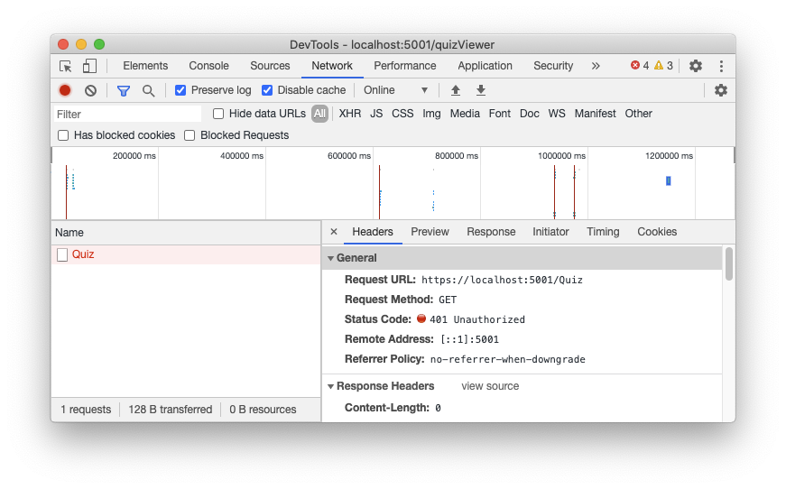

Slide 33
Calling the Protected API
To enable your Blazor WASM application to access the protected API, you need to get an access token from Auth0 and provide it along with your API call.
You might think to write some code that attaches this token when you make an HTTP request to the server.
However, you can centralize the access token attachment to your API calls in a straightforward way.

Slide 34
Manage Nuget package
Start by moving to the Client folder and installing the Microsoft.Extensions.Http package with the following command:
dotnet add package Microsoft.Extensions.Http
This package allows you to create named HTTP clients and customize their behavior.
Will create an HTTP client that automatically attaches an access token to each HTTP request.

Slide 35
Program.cs
Open the Program.cs file and add a reference to the Microsoft.AspNetCore.Components.WebAssembly.Authentication
In the Main() method, add the statements pointed out in the following code snippet

Slide 36
// Client/Program.cs
// ... existing code ...
public static async Task Main(string[] args)
{
var builder = WebAssemblyHostBuilder.CreateDefault(args);
builder.RootComponents.Add<App>("#app");
builder.Services.AddHttpClient("ServerAPI",
client => client.BaseAddress = new Uri(builder.HostEnvironment.BaseAddress))
.AddHttpMessageHandler<BaseAddressAuthorizationMessageHandler>();
builder.Services.AddScoped(sp => sp.GetRequiredService<IHttpClientFactory>()
.CreateClient("ServerAPI"));
//👆 new addition
// ... existing code ...
}
// ... existing code ...
// Note : check the names in Red

Slide 37
Program.cs
AddHttpClient() method defines a named HttpClient instance (ServerAPI) with the current server's address as the base address to use when requesting a resource.
Also, the BaseAddressAuthorizationMessageHandler class is added to the HttpClient instance as the HTTP message handler.
This class is provided by the Microsoft.AspNetCore.Components.WebAssembly.Authentication namespace and is responsible for attaching the access token to any HTTP request to the application's base URI.
The actual HttpClient instance is created by the CreateClient() method of the IHttpClientFactory service implementation.

Slide 38
In all Blazor Components
Wrap all the Http calls in the try catch block in all the component pages as shown
try
{
quiz = await Http.GetFromJsonAsync<List<QuizItem>>("quiz");
}
catch (AccessTokenNotAvailableException exception)
{
exception.Redirect();
}

Slide 39
Run the server
After applying these changes, restart your application, log in, and try to move to the Quiz page.
Unfortunately, you still will get an HTTP 401 status code, but with a different message
We are passing the access token.
However, the error message is saying that the access token is not valid.

Slide 40
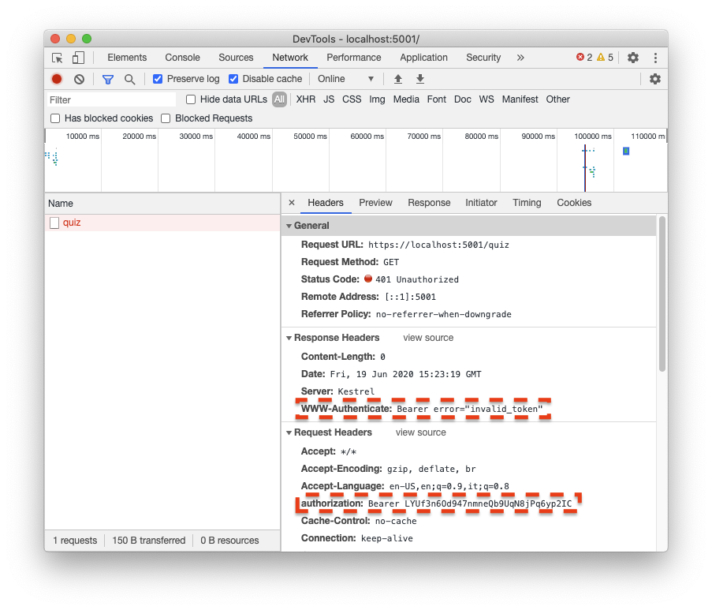

Slide 41
Why Error?
Blazor WASM has a limitation, as documented by this issue.
In a nutshell, in a standard authentication and authorization flow, you should be able to send the unique identifier of your API (the ApiIdentifier parameter, also known as the audience parameter) when you authenticate.
This way, the Auth0 authorization server will give you an access token that grants you specific access to that API.
Due to that limitation, your Blazor client is not explicitly requesting access to your API.
When Auth0 is not receiving the audience parameter, it emits an opaque and generic access token, as per specs.
This access token is not in JWT format and doesn't contain any information about the resource the token authorizes to access.
good news is that this issue will be resolved in .NET 6.

Slide 42
Defining a default audience
To overcome the current Blazor WASM limitation, you can define a default audience for your Auth0 tenant.
So, access your Auth0 Dashboard and navigate to your tenant settings.
Now, scroll down to the API Authorization Settings section and add your ApiIdentifier as the default API audience
Click the Save button to confirm your changes.
From now on, any client requiring an access token without specifying any audience parameter while authenticating will receive an access token related to your default audience.

Slide 43
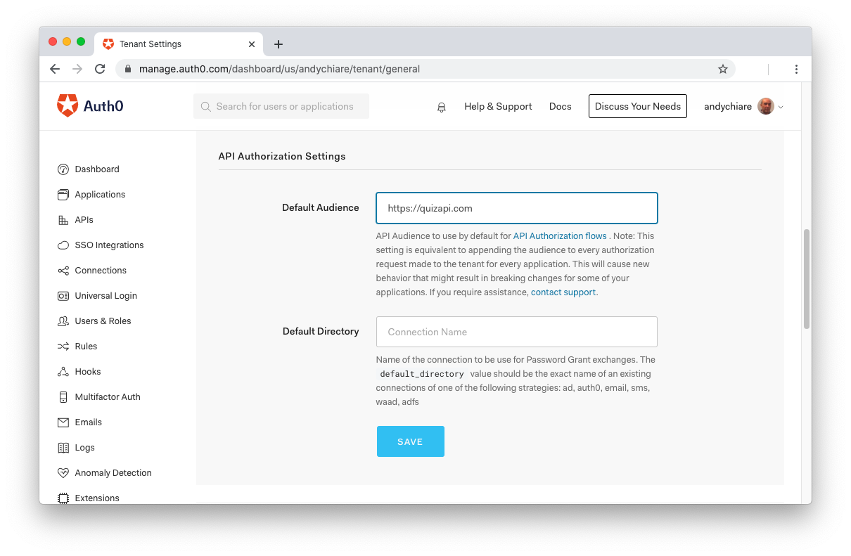

Slide 44
Run the application
Log out from the Blazor app and login again to get a new access token.
This time you should be able to access your protected API and show the protected component pages as well.

